Slide 1

Bosch Transport Data Logger TDL 110

Slide 2
Introduction
TDL 110 is a transport data logger which makes the delivery process of goods visible and traceable.
Once attached to the shipment, the TDL measures and records temperature, humidity, tilt, and shock.
The data captured by this sensor can be visualized through a mobile app.
The limits of each parameter are individually configurable, and any violation is traceable and clearly assignable throughout the entire supply chain.

Slide 3
Measured parameters
Temperature
Tilt
Shock
Humidity

Slide 4
Built-in sensors
Gyroscope
Humidity
Shock
Temperature

Slide 5
User interface
LED: show device status, battery level, communication.
Transport Data Logger App: free smartphone app for configuration / data analysis.

Slide 6
Communication interface
Wireless
Bluetooth low energy
Range: up to 40m (dependent on external influences)

Slide 7
Benefits
A simple yet versatile, reliable, and cost-effective delivery monitoring device that carries the Bosch seal of quality.
With its 360-degree approach, the TDL offers supply chain transparency and peace of mind.
In the event that a parameter threshold is exceeded, the TDL provides verifiable proof and a reliable indication of possible primary and secondary damage.
Individual configurability, ease of use, and effortless integration without prior knowledge requirements of the logistics chain.
The TDL provides added value regardless of the type of logistics involved.

Slide 8
Connecting to the TDL
First you have to download the bosch transport data logger app.
Activate Bluetooth on your phone and activate the TDL by pressing the button on it.
Start the Transport Data Logger app.
To find the activated TDL, tap Search.
Locate and select the TDL from the list.
Confirm the connection by selecting Pair.

Slide 9
Configuring the TDL
Choose and enter a name for the TDL (optional).
Enter an e-mail address to transfer data (optional). This e-mail address will be the default recipient address when sending data via e-mail.
Configure the logging interval. The measurement frequency depends on the required monitoring period of the TDL.
Choose a measurement parameter (temperature, humidity, tilt, shock) by tapping Set values.
Swipe up and down to configure minimum and maximum values.
Tap to continue.
Enter your desired PIN and confirm.
To start logging immediately: Tap Start logging and confirm that logging will start only when the TDL device is disconnected. The device confirms logging start by flashing three times the green LED.
To start logging later:
a. Tap Disconnect in the app. The device confirms the disconnection by flashing three times the red LED.
b. Then press the button on the TDL for 2 to 5 seconds when you want to start logging. The TDL blinks green three times to confirm that logging has started.

Slide 10
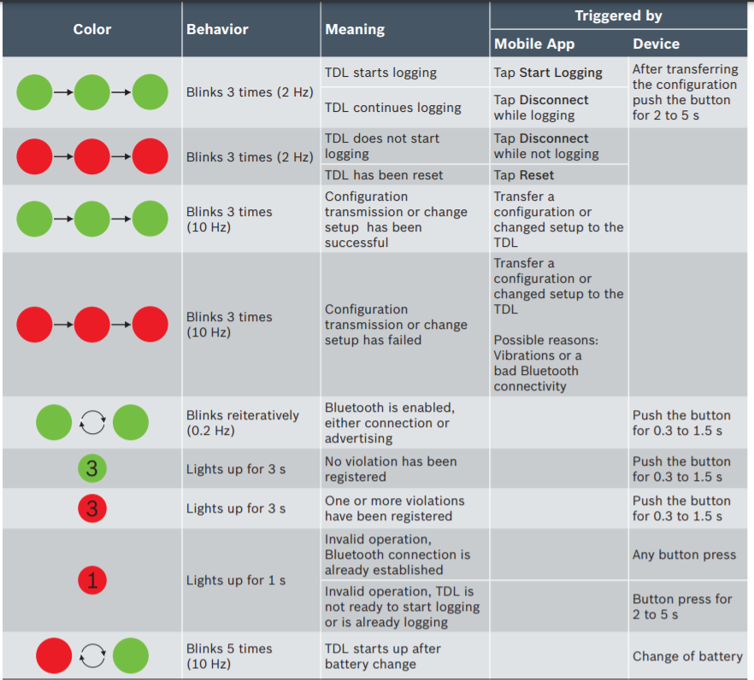
Blinking patterns

Slide 11
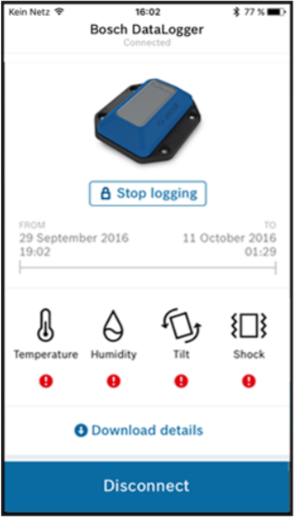
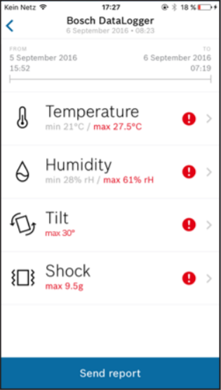
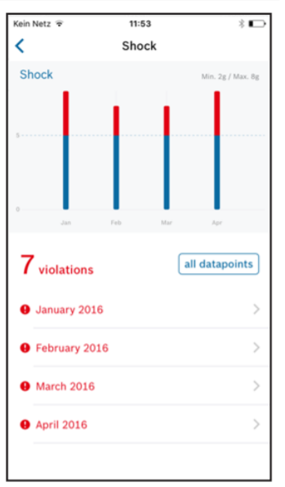
Reading the data
Connect your smartphone to a configured TDL.
Tap Download details.
Confirm Stop logging & download.
Enter your PIN.
Tap Show details. The summary screen appears.
Tap the desired measurement parameter to view those measurements.
Tap an entry date for more detailed information.

Slide 12
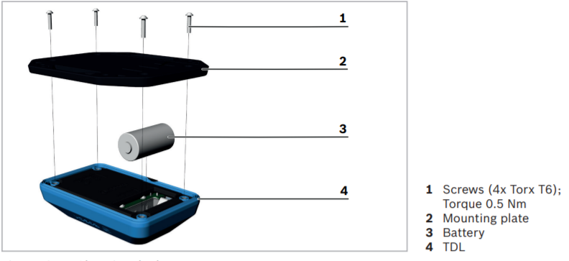
Changing the battery
Stop logging. If desired transfer the data to your smartphone (refer to Reading the Data on page 13).
Place the TDL down so that its bottom is facing upwards.
Remove the four screws by using a Torx T6 screwdriver.
Remove the mounting plate.
Change the battery (CR 123A Lithium Battery).
Position the mounting plate on the TDL.
Fasten the four screws with a torque of 0.5 Nm. The TDL is now ready for use and can be configured.

